Slide 1
RPi Node

Slide 3
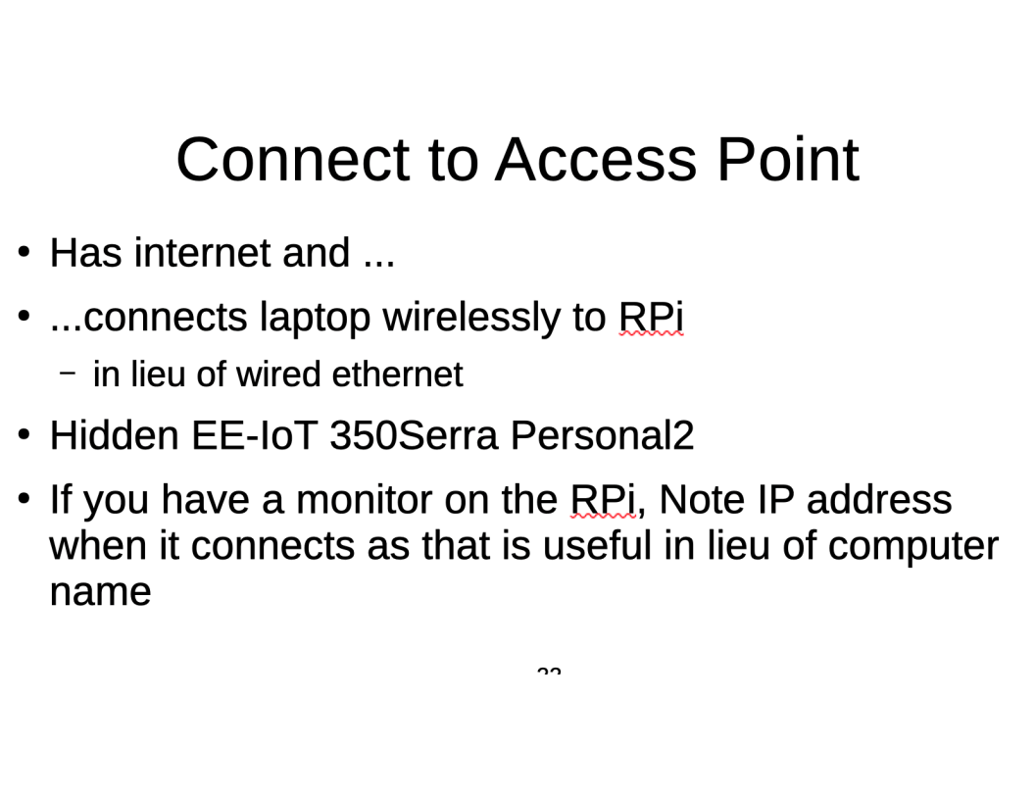
Installation of SX1280 cFS app and library
Objectives

Slide 4
Installation of SX1280 cFS app and library
Objectives
  Download, install and run the SX1280
  Test for interoperability with another transceiver

Slide 5
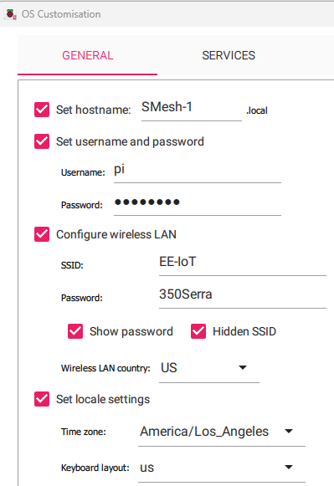
RPi Initialization
RPi Imager
Select the 64 bit full OS

Slide 6
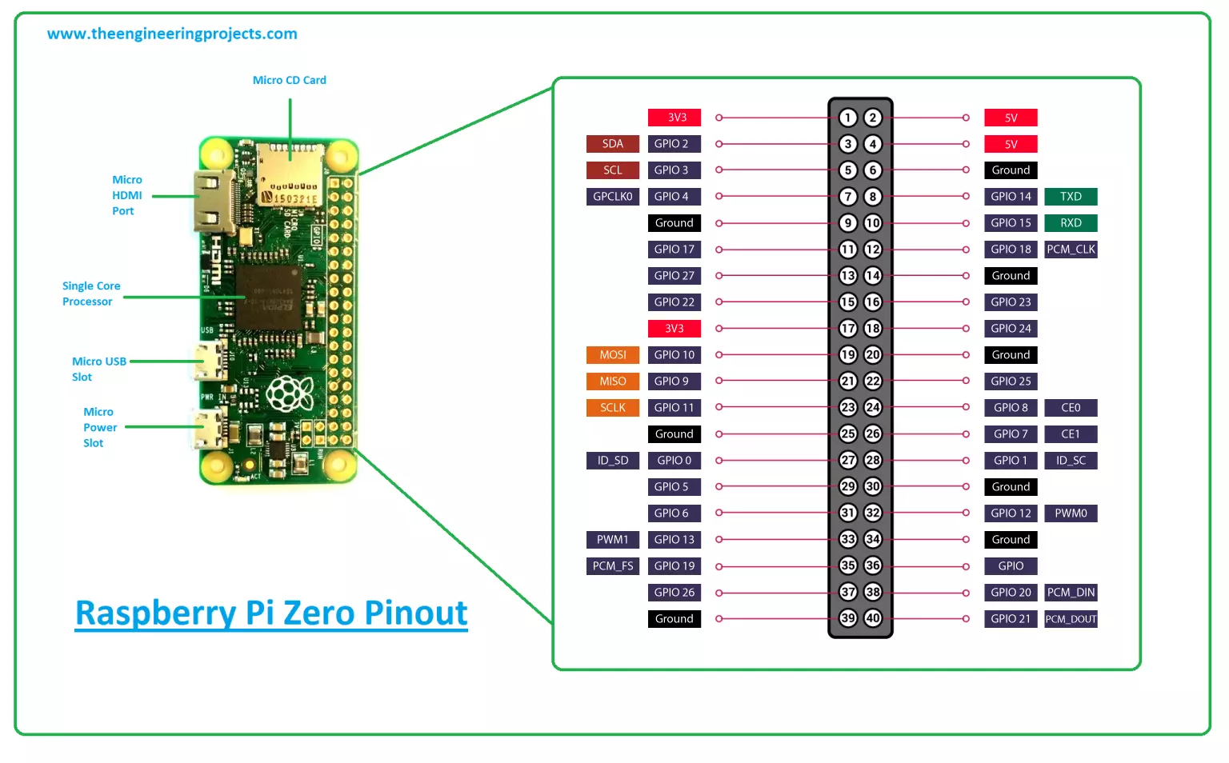

Slide 7
K6TJ-RPIZ2-x bringup - 1
64 bit legacy with GUI
Set ssh, wifi, country, timezone, etc
Hook up monitor
Ifconfig
Sudo Raspi-config
  Enable VNC; set VNC screen size to second largest one
  Enable SPI interface
Sudo apt update; sudo apt upgrade; sudo apt install x11-apps xterm

Slide 8
Connect to RPi
Use an ethernet cable from the RPi to your laptop, using a dongle at the laptop if necessary.
Share your WiFi internet connection with the wired ethernet port
arp -a or wireshark to get the autoconfigure address of the RPi
ssh -Y pi@w.x.y.z and run Xquartz or Xlaunch
  export DISPLAY=a.b.c.d:0.0
VNC w.x.y.z
pi
ceppsurc

Slide 9
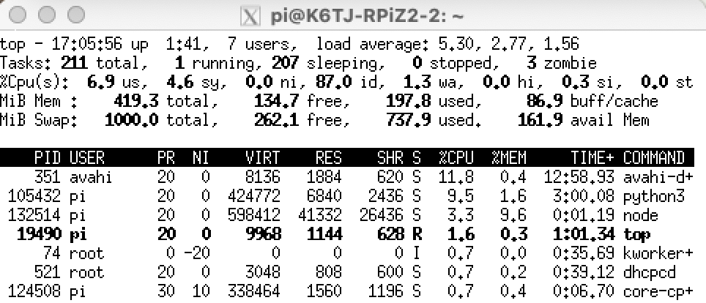
Increase swap
sudo nano /etc/sysctl.conf
# Changed swappiness from a default of 60 to 1 to decrease swap usage
vm.swappiness = 1
[turn off GUI in sudo raspi-config]
sudo dphys-swapfile swapoff
sudo nano /etc/dphys-swapfile
sudo dphys-swapfile setup
sudo dphys-swapfile swapon
[turn on GUI in raspi-config]
sudo reboot now
1000 MB
Basecamp and VS Code Remote
https://pimylifeup.com/raspberry-pi-swap-file/

Slide 10
Step 1. Open the system settings and click on "Network and Internet";
Step 2. On the left side of the window, click on "Wi-Fi". Now, on the right, click on "Manage known networks";
Step 3. Click on "Add new network";
Step 4. Finally, enter the data of the Wi-Fi network (name, security type and password) and click "Save". Remember to check the option "Connect automatically" so that the PC connects to the network whenever it is available.
The hidden Wi-Fi network will be saved and automatically connected to it whenever possible.

Slide 11
Crontab
# DO NOT EDIT THIS FILE - edit the master and reinstall.
# (/tmp/crontab.BMBP6Z/crontab installed on Sat Oct 12 11:04:29 2024)
# (Cron version -- $Id: crontab.c,v 2.13 1994/01/17 03:20:37 vixie Exp $)
# Edit this file to introduce tasks to be run by cron.
#
# Each task to run has to be defined through a single line
# indicating with different fields when the task will be run
# and what command to run for the task
#
# To define the time you can provide concrete values for
# minute (m), hour (h), day of month (dom), month (mon),
# and day of week (dow) or use '*' in these fields (for 'any').
#
# Notice that tasks will be started based on the cron's system
# daemon's notion of time and timezones.
#
# Output of the crontab jobs (including errors) is sent through
# email to the user the crontab file belongs to (unless redirected).
#
# For example, you can run a backup of all your user accounts
# at 5 a.m every week with:
# 0 5 * * 1 tar -zcf /var/backups/home.tgz /home/
#
# For more information see the manual pages of crontab(5) and cron(8)
#
# m h dom mon dow command
@reboot source /home/pi/.bashrc; cd /home/pi/Documents/github/smesh/snode; /home/pi/.local/bin/poetry install; /home/pi/.local/bin/poetry run python scripts/read_aqi.py /dev/ttyUSB0 >>data/read_aqi_stdouterr_log.txt 2>&1

